Slide 1

Topic:-Green Techonology
Presenter Name:-Jadhav Rajvardhan Vijay

Slide 2


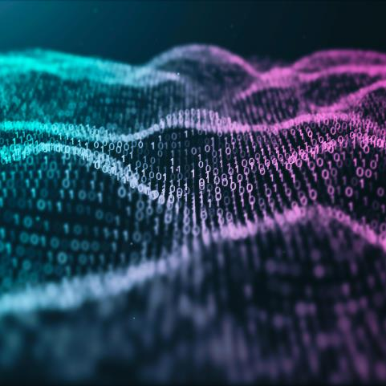
Content:-
Topic one:-Introduction to Green Energy.
Topic two:-Goal to Achive Green Technology.
Topic three:-Types of Green Energy.
Topic four:-Advantages and Disadvantage.

Slide 3
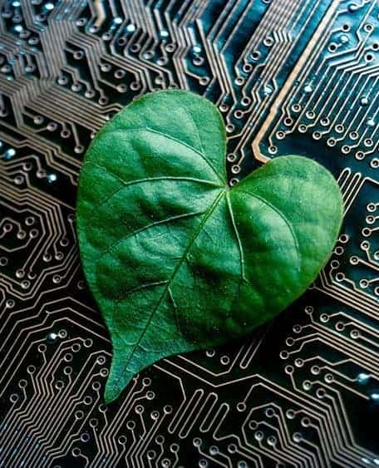
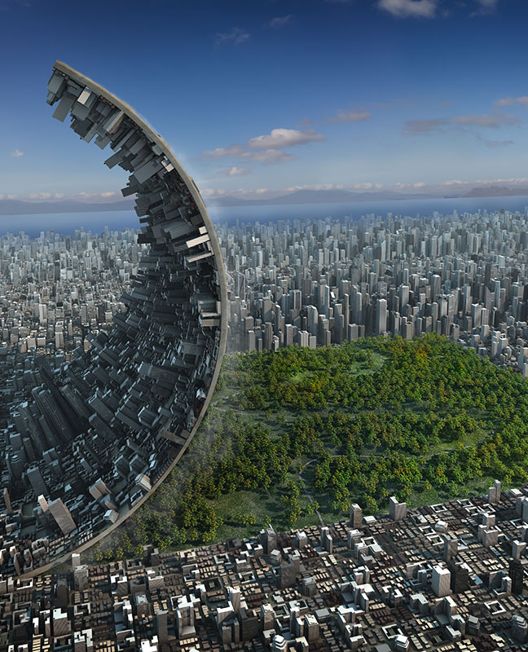


Introduction
Renewable energy is energy that is collected from renewable resources that are naturally replenished on a human timescale. It includes source such as suinlight,wind,the movement of water and geothermal heat.

Slide 4

Goal to Achive Green Technology:-
Recycle
Refuse
Renew
Response
Reduce
Reduce.
Recycle.
Refuse.
Renew.
Responsibility.

Slide 5
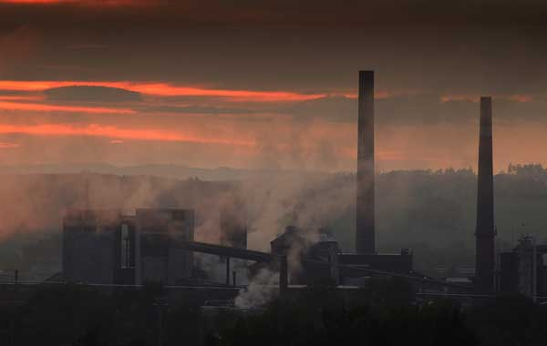
Reduce
Fuels.
Waste.
Energy consumption.
Wastage of clean water.

Slide 6
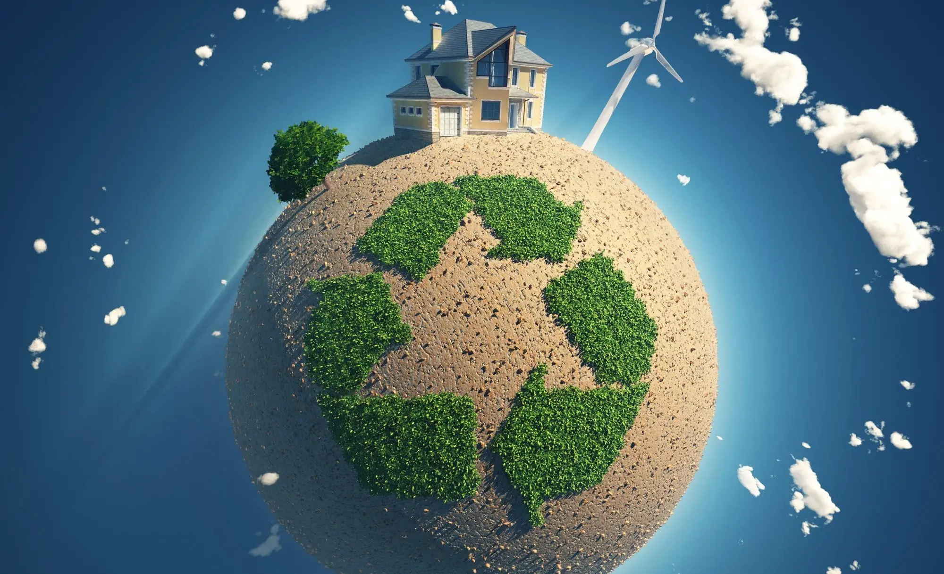
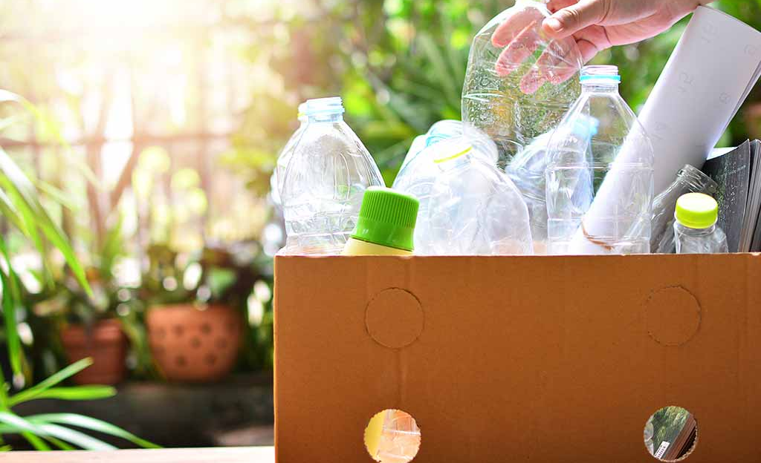
Recycle
Paper.
Plastic.
Cans.
Batteries.
Clothing.

Slide 7
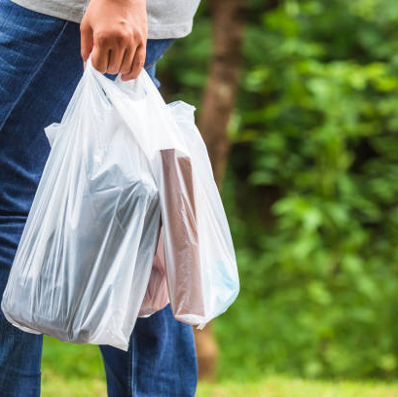
Refuse
Refuse to use plastic bag
Refuse to use tea bag
Refuse to use plastic cup

Slide 8
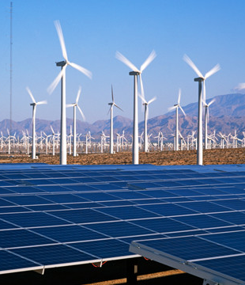
Renew
Wind Energy
Solar Energy
Water Energy
Wast Water
Bio-Fuel

Slide 9


Responsibility
Don’t waste
Don’t waste electricity-switch off electricity equipment when not required.
Don’t waste
Don’t waste water-Never leave taps open while brushing or washing dishes.
Don’t waste
Don’t waste fuel.
Do
Don’t’ waste water food-Don’t cook extra food and throw,always keep in mind that there are million in the world starving without food

Slide 10
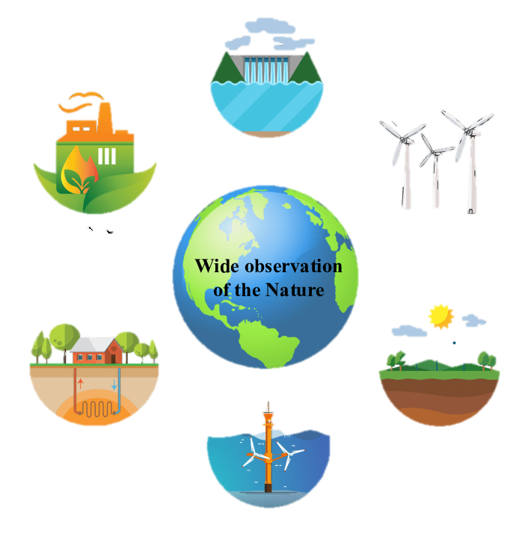
Types of Green Energy:-
Wind Energy.
Solar Energy.
Tidal Energy.
Geothermal Energy.
Biomass Energy.
Hydro Energy.

Slide 11
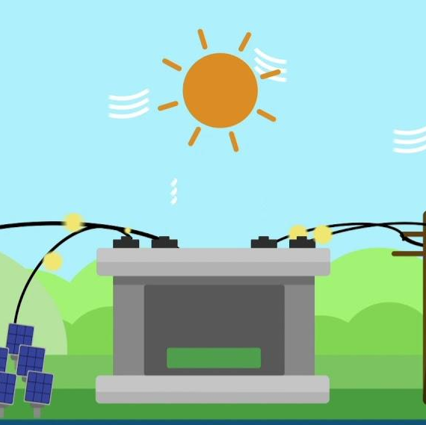
How to store renewable
Batteries are probably the most familiar method of storing energy. Humans use batteries in all sorts of electrical devices, from smartphones to cars. The most popular batteries are lithium-ion batteries, which are used in small devices and also make up more than 90% of battery storage on the global electricity grid

Slide 12

5 ways to boost renewable energy investment in developing economies
Regulated, transparent power arrangements.
Specific clean energy/climate incentives.
General business-friendly measures.
Innovative financing mechanisms.
Early risk assumption.

Slide 13
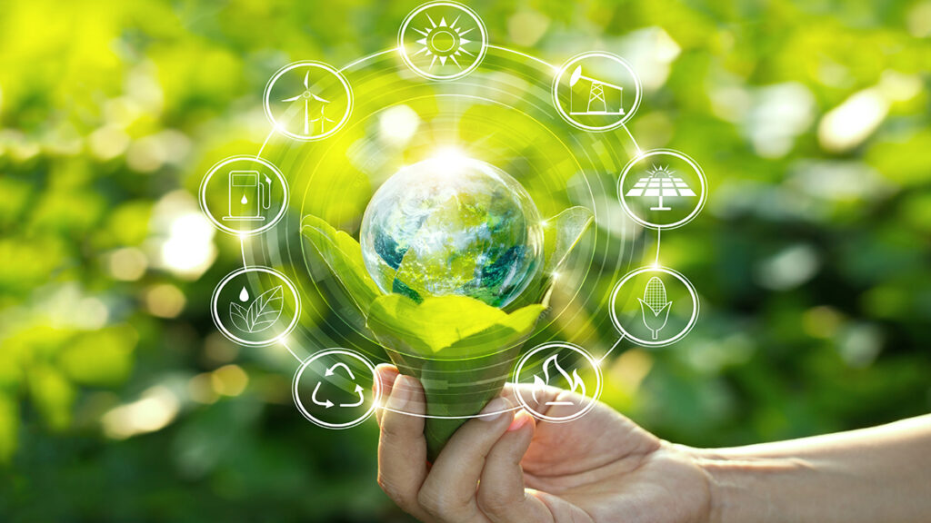
5 examples of green technologies that are environmentally-friendly
Wastewater treatment
Elimination of industrial emmisions.
Recycling and waste management.
Waste to Energy.
Generation of energy from the waves.

Slide 14
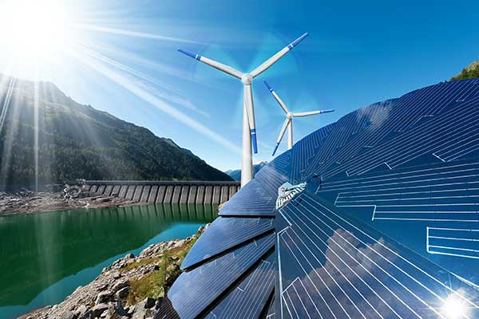
Advantages
Less global warming.
Improved public health.
Inexhaustible energy.
Jobs and other economic benefits.
Stable energy prices

Slide 15
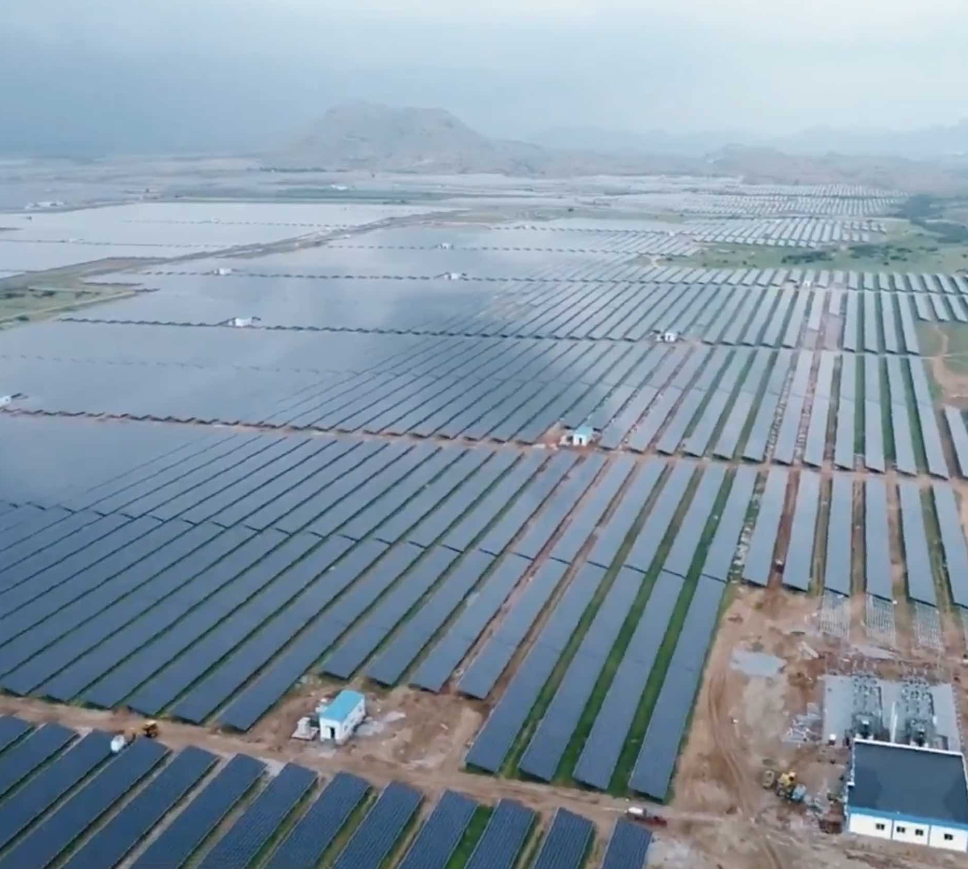
Disadvantage
The Electricity Generation Capacity is Still Not Large Enough. ...
Renewable Energy Can be Unreliable. ...
Low-efficiency Levels. ...
Requires a Huge Upfront Capital Outlay. ...
Takes a Lot of Space to Install

Slide 16
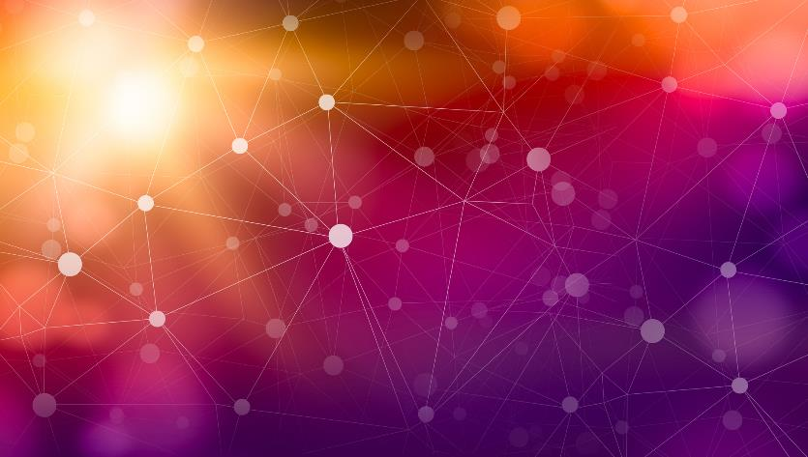
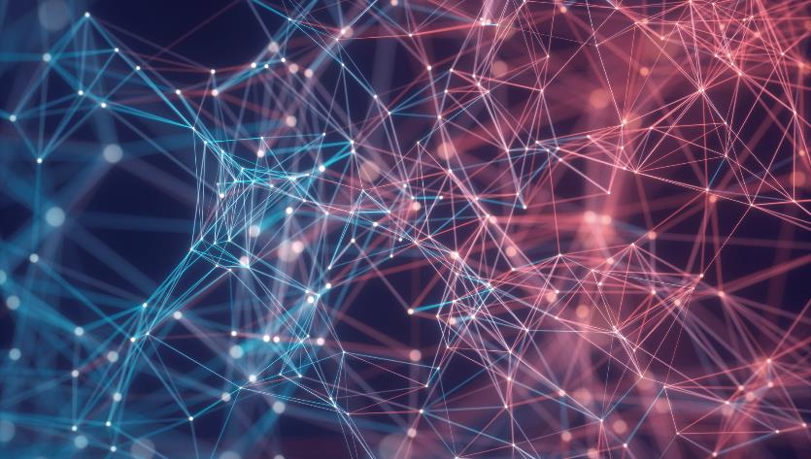
Thank You

